Slide 1
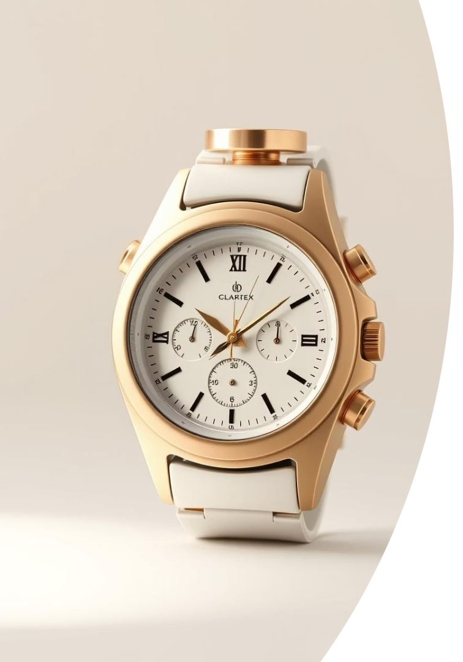

The StopWatch/Clock: Time, Perfected
Introducing a hybrid device combining stopwatch and clock functions.
An essential tool for precision timing and daily time awareness.
Experience functionality, convenience, and style all in one.
by Likhitha Polagani

Slide 2
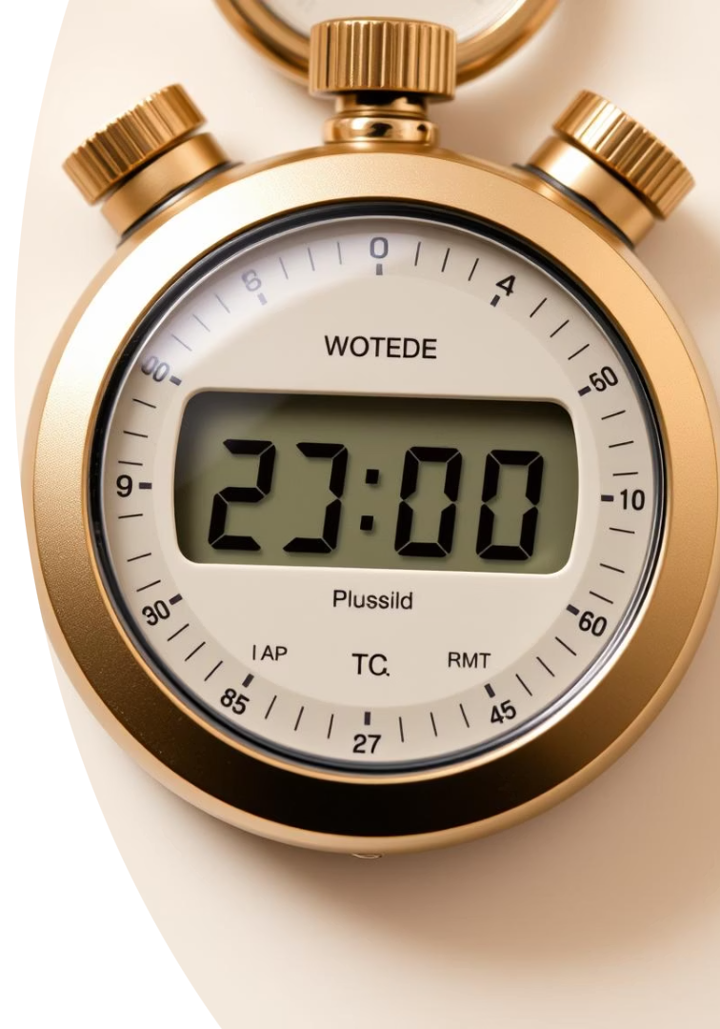
Core Functionality: Stopwatch
High-Precision Timing
Control Functions
Start, stop, and reset with ease for detailed measurement.
Measures elapsed time accurately to 1/100th of a second.
Split/Lap Recording
Record multiple time segments in one session for analysis.

Slide 3
Core Functionality: Clock
Continuous Time Display
Dual Modes
Time Awareness
Shows current time clearly in hours, minutes, and seconds.
Supports AM/PM and 24-hour formats for flexible use.
Ensures you stay updated with accurate current time.

Slide 4
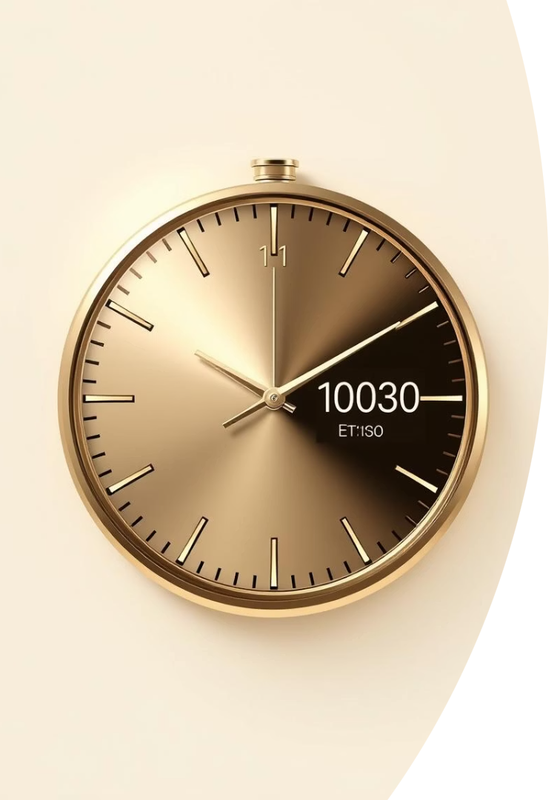
Key Features: Seamless Integration
Dual Display
View elapsed time and current time simultaneously.
Mode Switching
Easily toggle between stopwatch and clock modes.
Intuitive Interface
Simple controls for smooth and effortless operation.
Streamlined Design
Compact and efficient layout for maximum usability.

Slide 5




Benefits: Efficiency and Convenience
Clutter Reduction
Time Management
Combines two tools in one to save space.
1
2
Boosts productivity with precise tracking for tasks.
Enhanced Focus
Versatile Usage
4
3
Improves accuracy with convenient timing functions.
Ideal for athletes, coaches, scientists, and professionals.

Slide 6
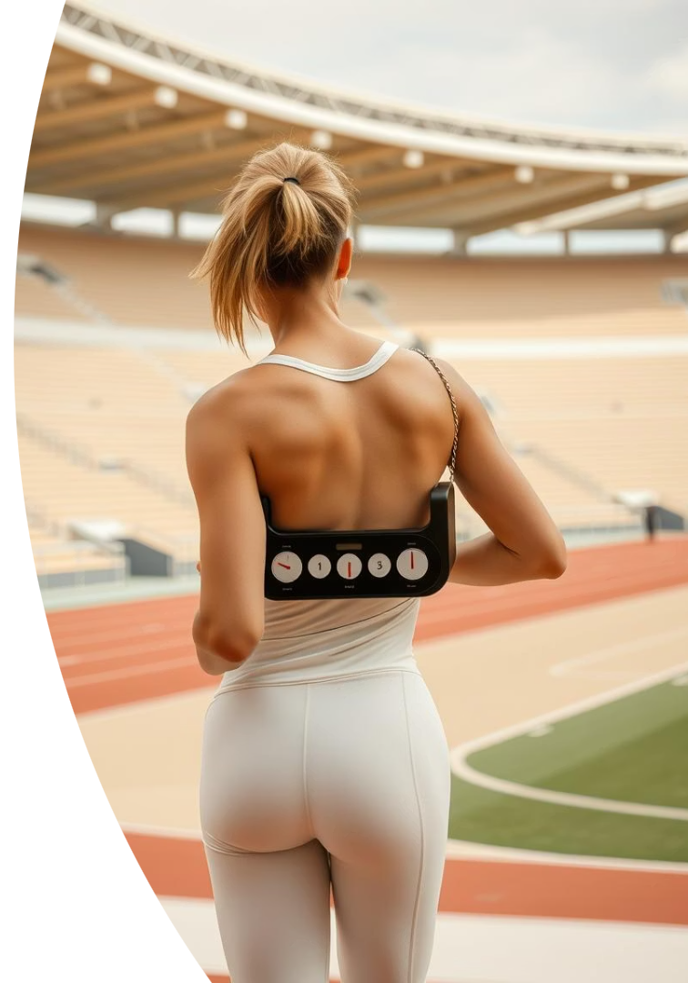
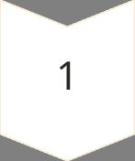
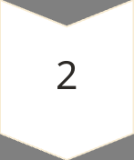
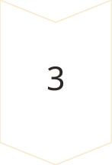
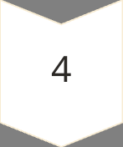
Use Case: Athletic Training
Workout Tracking
Measure workout and lap times for performance insights.
Interval Training
Optimize race pacing with precise interval timing.
Progress Monitoring
Track improvements and refine training routines effectively.
Trusted by Coaches
Used by 80% of Olympic coaches for athlete success.

Slide 7
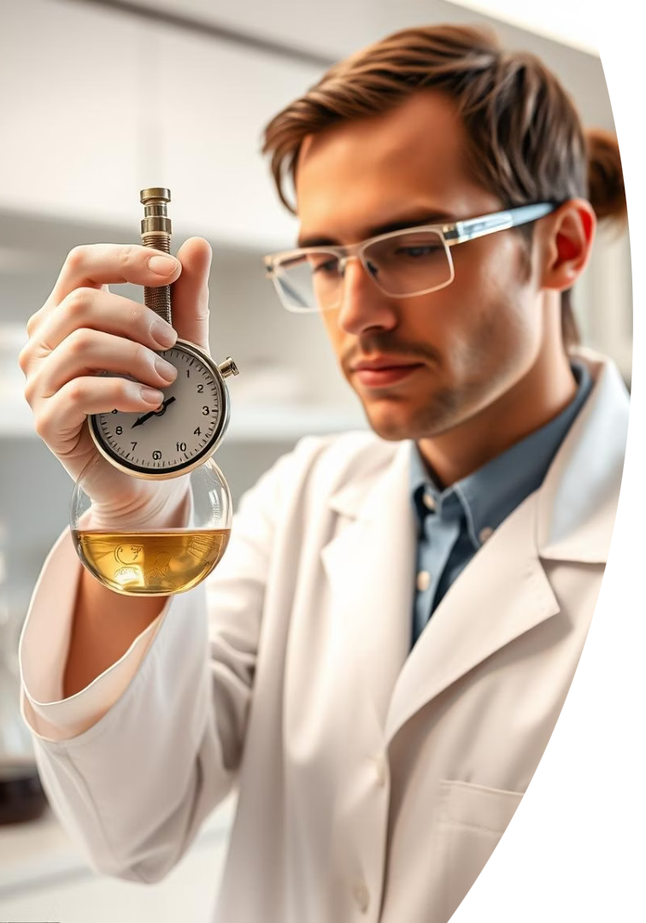
Use Case: Scientific Experiments
Accurate Timing
Measures experiment durations with high precision and reliability.
Data Recording
Supports meticulous data collection and experiment documentation.
Research Consistency
Ensures reliable timing for reproducible results.
Wide Application
Essential in labs, research centers, and universities.

Slide 8

Use Case: Project Management
Task Monitoring
Track duration of tasks and overall project timelines.
Billing Accuracy
Manage billable hours effectively for client projects.
Workflow Efficiency
Enhance accountability and streamline processes.
Corporate Use
Utilized by 75% of Fortune 500 for project tracking.

Slide 9





Future Innovations and Enhancements
Smart Device Integration
Advanced Data Logging
Customizable Profiles
User Satisfaction Boost
Targeting a 50% increase in user satisfaction through innovations.

Slide 10
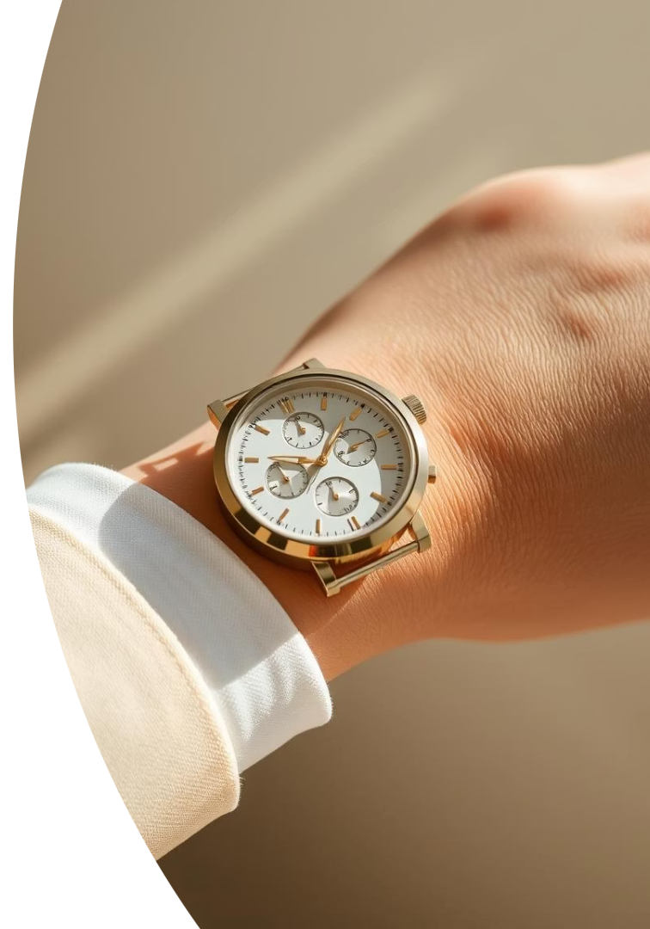
Conclusion: The Ultimate Timekeeping Solution
The StopWatch/Clock combines accuracy, efficiency, and convenience.
Ideal for athletes, scientists, and professionals valuing time.
Invest in precision; invest in your ultimate timekeeper.

